Slide 1


Department of Computer Science and Engineering
TRANSLATING MEDICAL NOTES INTO ICD CODE
Dr.M.Rakesh Kumar.,M.E.,Ph.D.,
Assistant Professor
SHUBALEKHA G 220701275
SREENIDHI K 220701285

Slide 2
Problem Statement
Translating Medical Notes into ICD-10 Codes
Description: Develop tools or methodologies to accurately interpret medical notes and translate them into appropriate ICD-10 codes. The goal is to improve coding accuracy, streamline documentation processes, and support effective patient care.

Slide 3
Existing System
Currently, the assignment of ICD codes is predominantly a manual process performed by trained medical coders. These methods heavily rely on human expertise and interpretation of medical records, which often leads to:
Time-consuming and labor-intensive workflows
Inconsistencies and inaccuracies due to subjective interpretation
Limited scalability in large healthcare settings
Risk of human errors and misclassification
Increased workload for healthcare providers and administrative staff
Additionally, existing rule-based automated coding systems lack flexibility and fail to accurately interpret complex, unstructured symptom descriptions. These systems are not adaptive to evolving clinical language and often require constant manual updates. Consequently, there is a growing need for an intelligent, accurate, and automated solution that can process free-text symptom descriptions, predict appropriate ICD codes efficiently, and reduce the burden on healthcare professionals — thereby improving overall healthcare documentation quality and operational efficiency.

Slide 4
Objectives
The objective of the " Translating Medical Notes into ICD-10 Codes " is to develop a robust machine learning-based application that accurately predicts ICD diagnosis codes from clinical symptom descriptions. The system aims to:
• Automate and simplify the ICD coding process for healthcare professionals
• Enhance the accuracy and efficiency of disease coding
• Minimize manual errors and reduce the workload on clinical coders
• Provide a user-friendly web interface for seamless interaction
• Ensure model reliability through extensive performance evaluation
• Support healthcare documentation, epidemiological studies, and healthcare billing with accurate and standardized diagnostic codes
By leveraging NLP techniques and machine learning algorithms such as Logistic Regression and Random Forest, the system ensures high prediction accuracy, improves clinical workflows, and contributes to more structured and efficient healthcare data management.

Slide 5
Abstract
Translating Medical Notes into ICD-10 Codes is an intelligent system designed to automate the diagnosis coding process by transforming unstructured medical text into structured ICD-10 codes. Leveraging advanced Natural Language Processing (NLP) and Machine Learning (ML) techniques, this system analyzes clinical notes and predicts the most relevant diagnosis code, significantly improving accuracy and efficiency in medical documentation . The platform applies TF-IDF vectorization to extract meaningful features from clinical language and uses classification models such as Logistic Regression and Random Forest to predict the appropriate ICD-10 code for each medical note. The system’s performance is evaluated using metrics such as accuracy, precision, recall, and F1-score to ensure high reliability in code assignment . By automating a critical aspect of healthcare data processing, this project addresses inefficiencies in manual coding, reduces human error, and supports scalable deployment across clinical systems — ultimately contributing to improved patient care and administrative efficiency.

Slide 6
Proposed System
Translating Medical Notes into ICD-10 Codes is an innovative solution designed to automate and streamline the assignment of standardized ICD codes based on clinical symptom descriptions. It leverages advanced machine learning algorithms such as Logistic Regression and Random Forest Classifier to predict accurate diagnostic codes from unstructured clinical text with high precision.
The system utilizes Natural Language Processing (NLP) techniques, including TFIDF vectorization, stopword removal, and lemmatization, to effectively process and analyze symptom descriptions provided by healthcare professionals. Through these preprocessing methods, the model extracts key features from the text and maps them to the most relevant ICD codes.
A carefully curated and labeled dataset containing symptom–ICD code pairs is used to 17 train and evaluate the classification models. To ensure user accessibility and practicality, the system is integrated into a Flask-based web application, providing an intuitive interface where users can input patient symptoms and obtain predicted ICD codes in real time.
By improving accuracy and efficiency in ICD code assignment, this system reduces manual workload, minimizes coding errors, enhances healthcare documentation, and supports better healthcare data management. Ultimately, the ICD Code Prediction System fosters more reliable and streamlined clinical workflows, contributing to improved healthcare delivery.

Slide 7
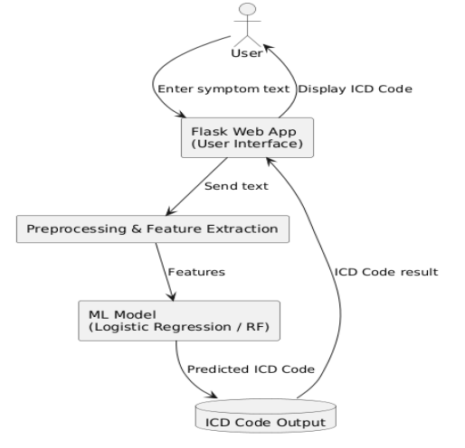
System Architecture
The ICD Code Prediction System integrates machine learning to automate ICD code prediction from clinical symptom descriptions. The process begins with a labelled dataset of symptoms and ICD codes. Text preprocessing (cleaning, stopword removal, lemmatization) prepares the data, followed by TF-IDF feature extraction. Logistic Regression and Random Forest models are trained for classification, with performance evaluated using accuracy, confusion matrix, and classification report . The optimized model is deployed via a Flask web app for real-time prediction. All data, including trained models and results, are stored centrally. The system offers efficient preprocessing, reliable classification, and a user-friendly interface for ICD code prediction.

Slide 8
List of Modules
User Interface Design
Backend Infrastructure
Data Collection & Preprocessing
Feature Extraction
Classification & Model Selection
Performance Evaluation & Optimization
Model Deployment
Centralized Server & Database
System Workflow (User Interaction, ICD Prediction, Result Display, Continuous Learning)

Slide 9
Functional Description for each modules with DFD and Activity Diagram
User Interface Design — Web interface for symptom input and ICD code display
Data Collection & Labelling — Prepare symptom descriptions paired with ICD codes
Data Preprocessing — Clean text, remove stopwords , lemmatize
Feature Extraction — Convert text to numerical features using TF-IDF
Model Training & Classification — Train Logistic Regression and Random Forest models
Performance Evaluation — Evaluate using accuracy, confusion matrix, classification report
Model Deployment — Deploy trained model using Flask web application
Centralized Database — Store trained models, predictions, and evaluation metrics
System Workflow — Real-time prediction and output to users

Slide 10
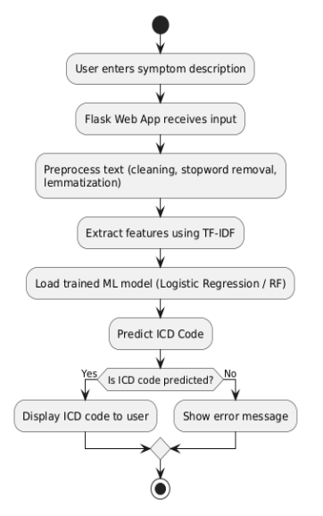
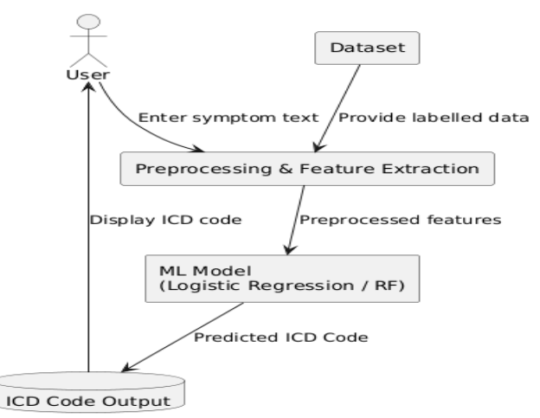
Dataflow diagram
Activity diagram

Slide 11
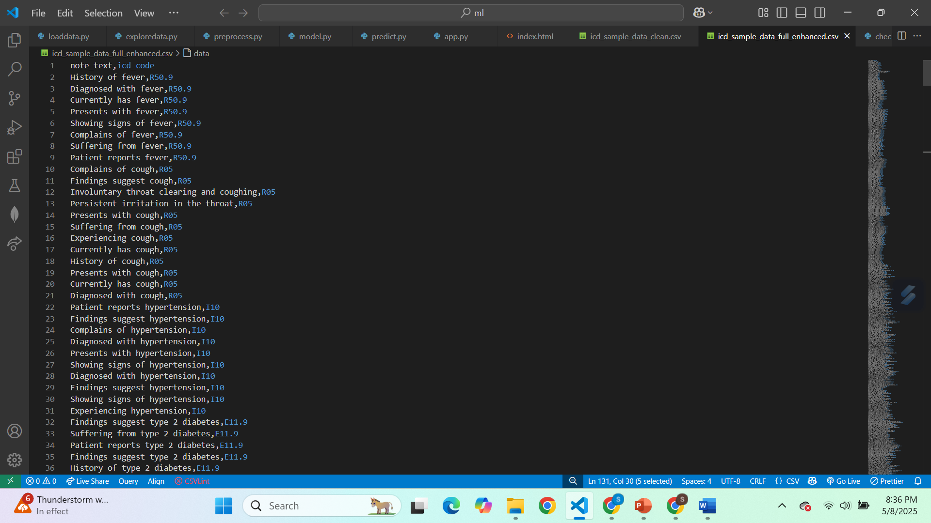
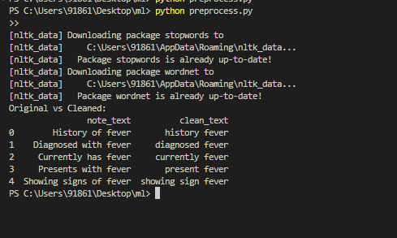
Implementation & Results of Module
DATASETS
PREPOCESSING OUTPUT

Slide 12
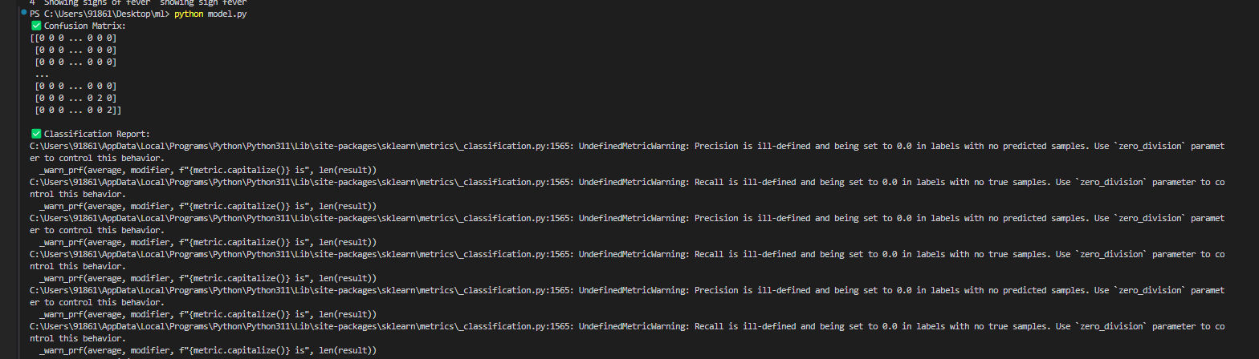
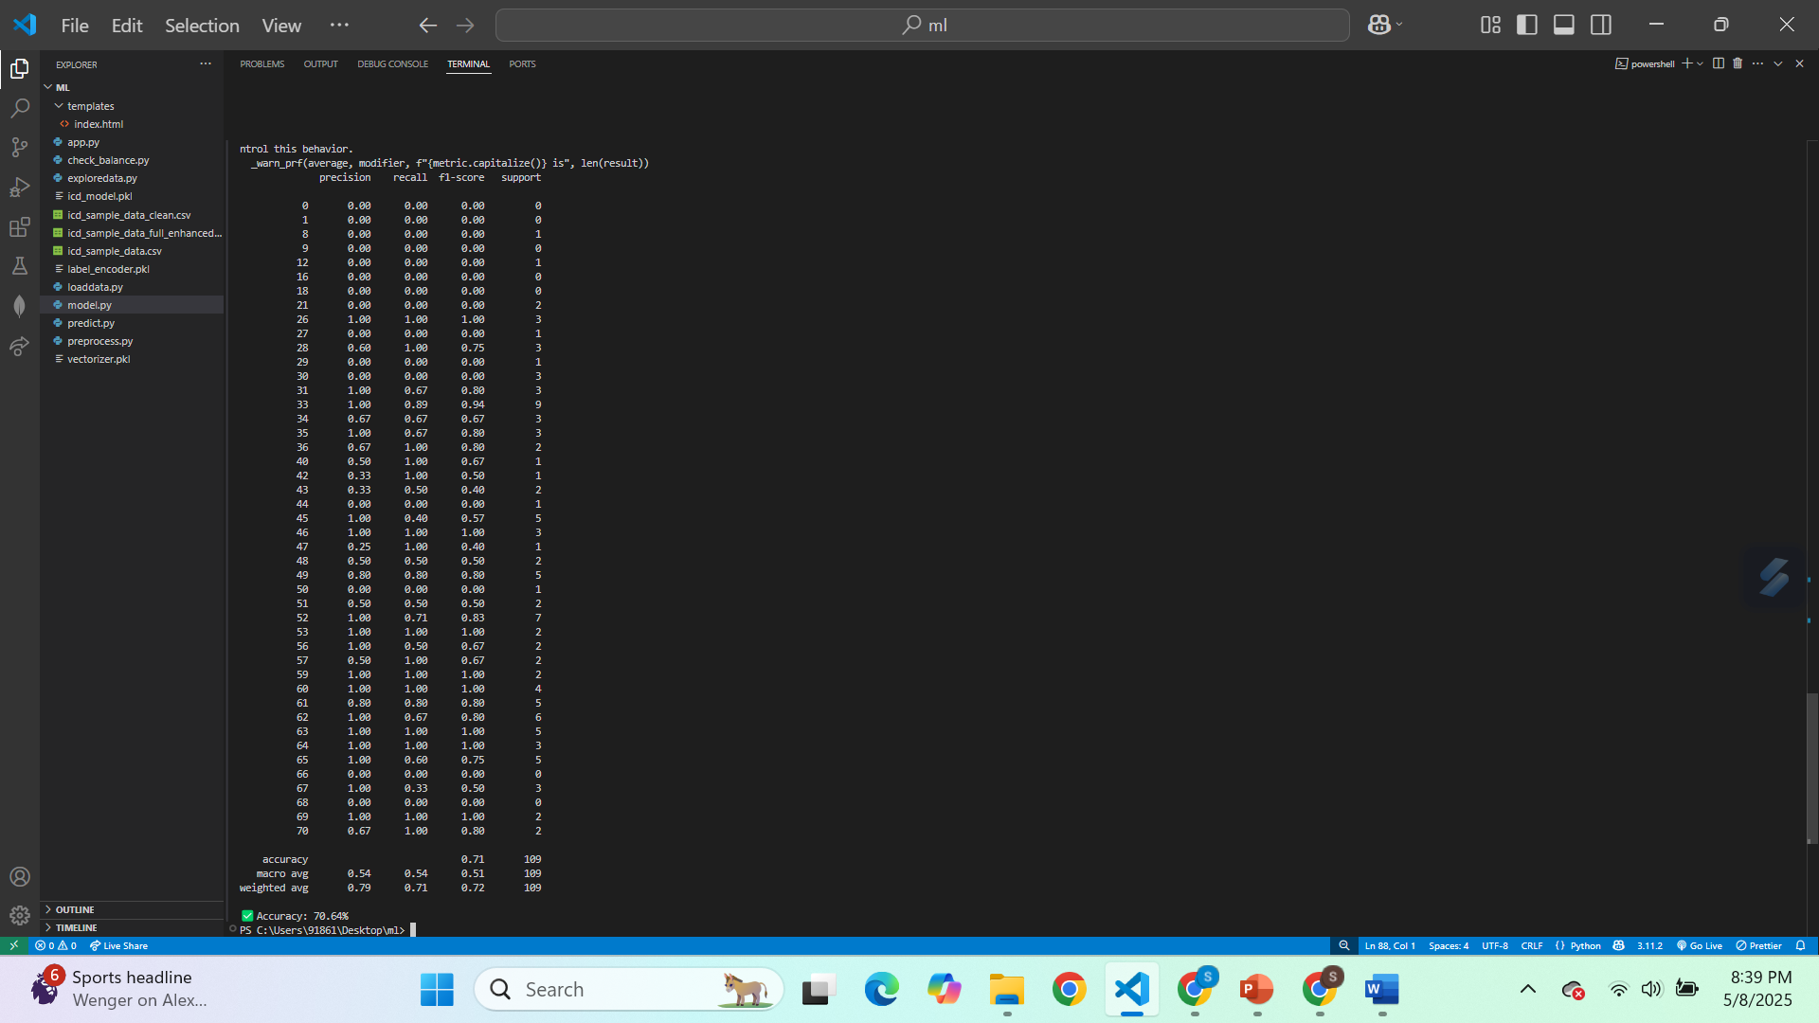

Slide 13
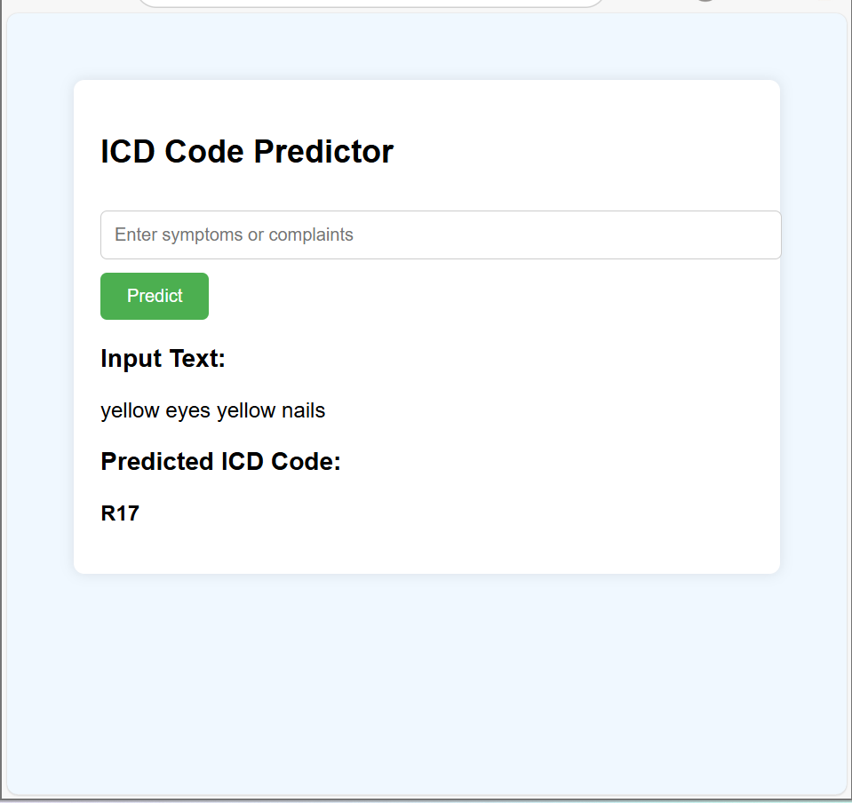
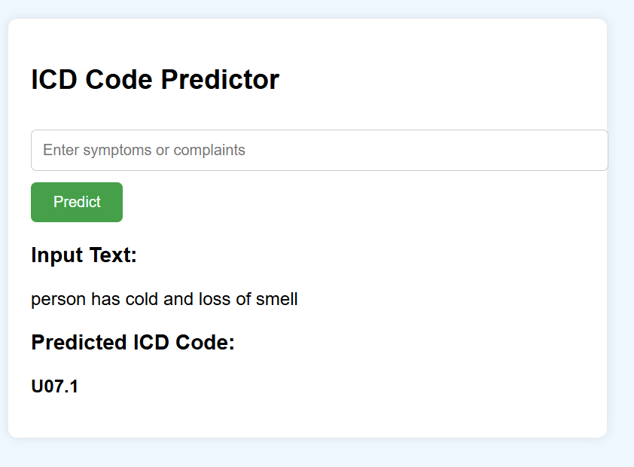

Slide 14
Conclusion & Future Work
The proposed system uses Machine Learning and NLP to automate ICD code prediction from clinical symptom descriptions, improving accuracy, efficiency, and reliability over manual coding . With TF-IDF, Logistic Regression, and Random Forest, the system ensures robust feature extraction and precise classification. The Flask-based web app enables real-time ICD code assignment, reducing manual workload, minimizing errors, and improving the consistency of healthcare documentation.
Future improvements include integrating deep learning models (e.g., CNNs, BERT) for advanced, context-aware text analysis. Using pre-trained biomedical models can improve understanding of medical terminology and enhance prediction accuracy . Transfer learning techniques can help the system quickly adapt to new clinical datasets and evolving medical terms without extensive retraining.

Slide 15
Thank You

